Slide 1
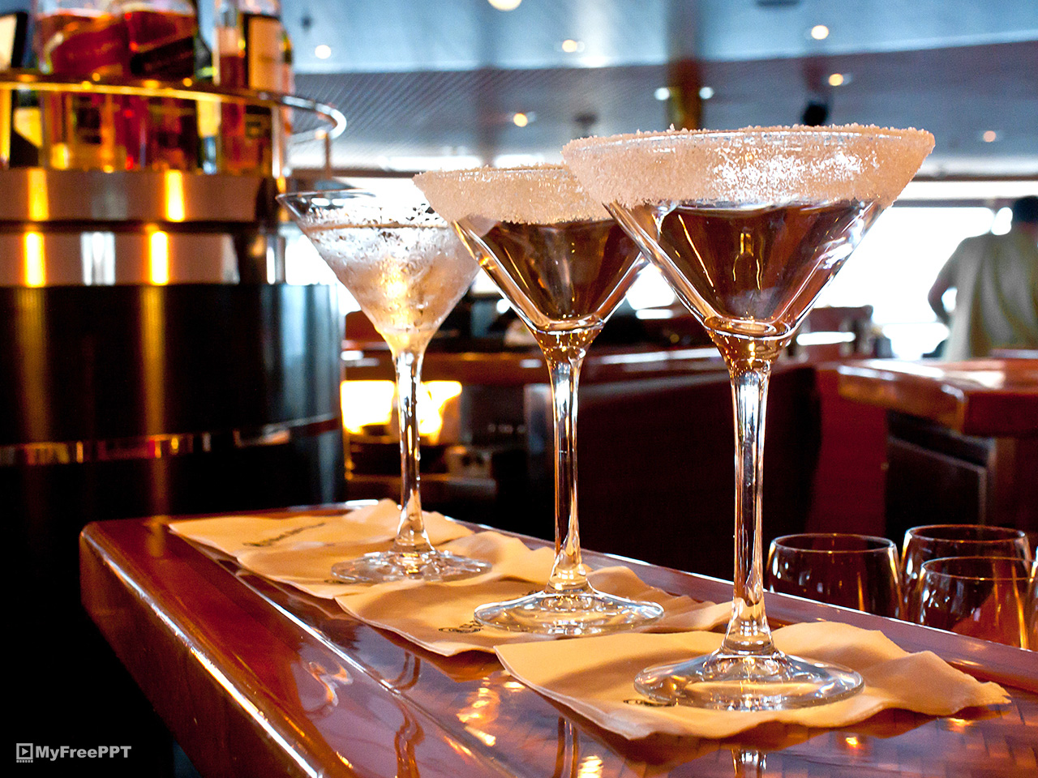
182065 A.H.O.L Kaushani
Celebration Spirits

Slide 2
CONTENT
Introduction
Objectives
Requirements
Features
Technology and Tools
Conclusion

Slide 3
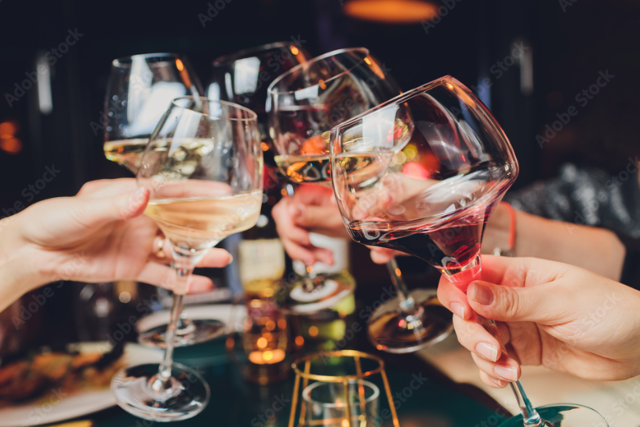
INTRODUCTION
Alcoholic beverages and bites order system is mainly designed primarily function for use in the beverage delivery industry.
This system enabling all our customers to order the vital ranges of alcoholic beverages and bites.

Slide 4

OBJECTIVE
To provide fast and convenient alcoholic beverages and bite ordering and delivering service for the customers who are organizing or holding special events.

Slide 5
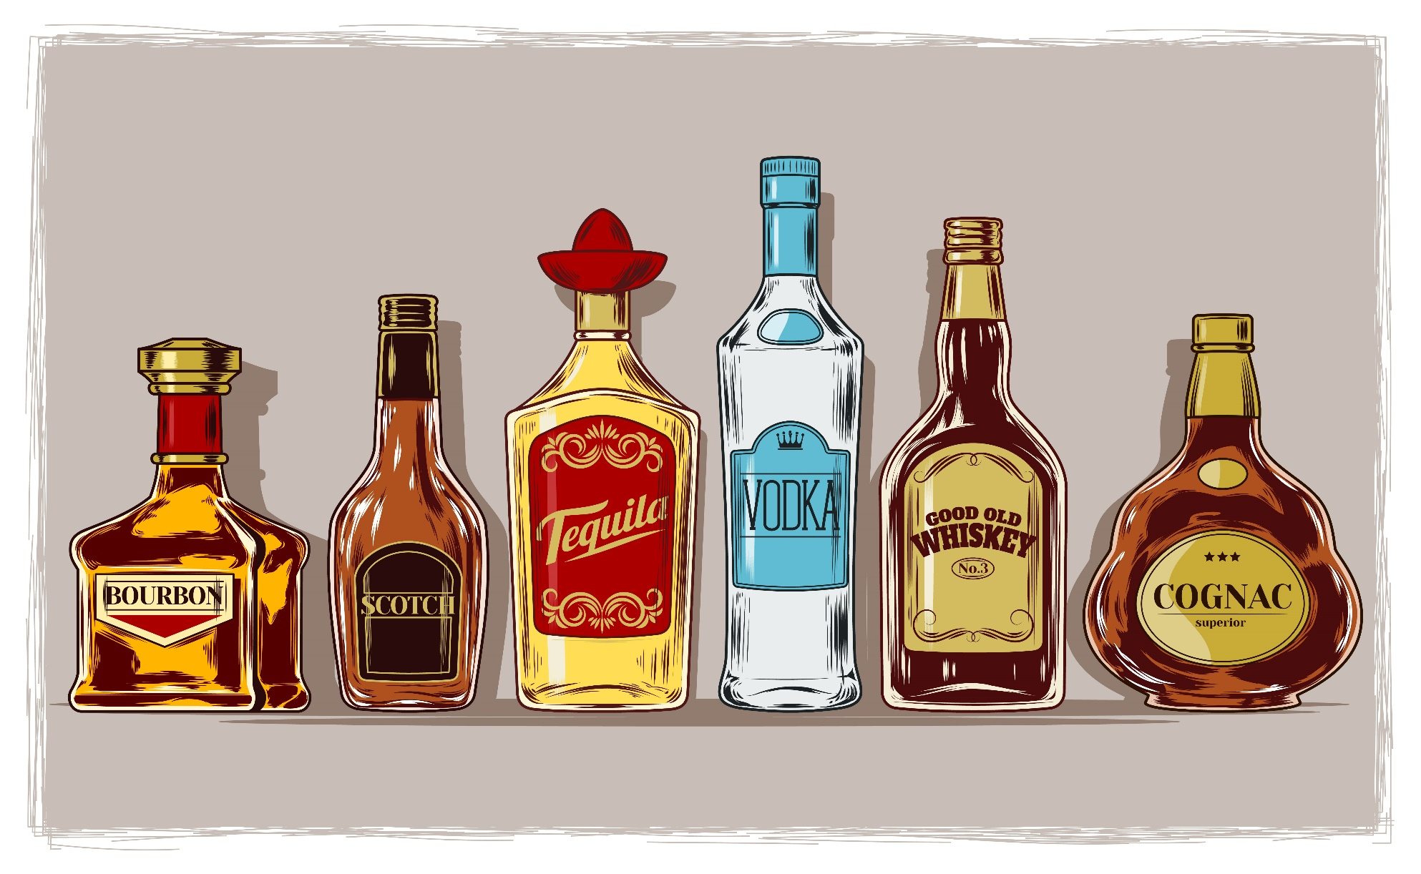
FUNCTIONAL REQUIREMENTS
Allow user to view shopping cart
Allow user to edit billing details if necessary
Allow user to place the order
Allow user to view available items in the store
Allow user to register and login
Allow admin to view placed orders

Slide 6
NON-FUNCTIONAL REQUIREMENTS
Simple and easy to use
User friendly
24 hours convenient
Save time
Quality of the service

Slide 7




TECHNOLOGY AND TOOLS
HTML
CSS
PHP
MYSQL

Slide 8
CHALLENGES
We do not have merchant account to handle online payment.
Difficult to express ideas through online platforms.

Slide 9
CONCLUSION
With this website, users can check the availability and the price of the type of liquor that they hope to buy.

Slide 10
DEMONSTRATION

Slide 11
THANK YOU

